Slide 1


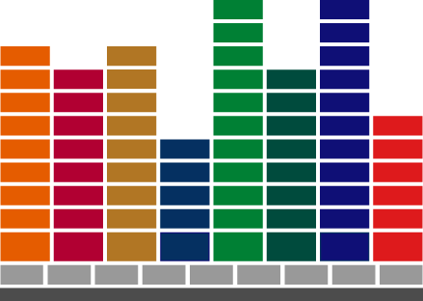

Slide 2
Sconf-Session II
Dhammika Jayasinghe
23 Jan 2009

Slide 3
Agenda
Transfer configuration
Overview on ‘design tab’
    Page design
    Proposal generator /Order entry/Report generator
    Screen generator

Slide 4
Transfer Configuration
Sales quotations created using SCONF, can be transferred to the Centura side as an incoming customer order

Slide 5
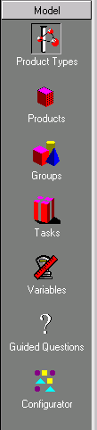
Workshop Subsystems
-
Model
Add, update and delete Product Type info (Super-Product level).
Add, update and delete Items, their Rules and Constraints.
Define Item Groups and their behavior (1st degree).
Define actions, using Rules. (i.e Functions or Procedures).
“All-in-one” frame for product level Variables divided into sub-categories.
Selection definition for the GQ Wizard
Define the visual “catalogs” for the SC user.

Slide 6
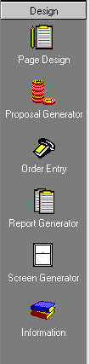
Workshop Subsystems
-
Design
Create Sections to be used in PG, OE and RG.
Create Templates for Proposals and Quotes.
Create Order Entry forms.
Create Templates for Reports.
Create Data Entry screens appearing in SC.
Create General, not item specific, information for your System.

Slide 7
Design Tab
Page design -Create the sections used in templates for proposals, reports, and order entry forms
Proposal Generator-Build quotes and proposal templates for IFS Sales Configurator using the sections created in the Page Design subsystem
Order entry -Build order entry forms for IFS Sales Configurator using the sections created in the Page Design subsystem
Report generator -Build report templates for IFS Sales Configurator using the sections created in Page Design subsystem
Screen Generator -Design data entry screens that appear in IFS Sales Configurator
Information -Enter general information about your system (this subsystem contains nothing specific about products)

Slide 8
Overview
Proposal Generator
Report generator
Order entry
Page Design

Slide 9
Page design
Template used in Proposal Generator, Report generator, and Order entry
Use HTML Documents
Variables & in-built functions to pass required values

Slide 10
Proposal Generator
Use pages designed through “Page design” functionality
IFS example
Report generator and Order entry are designed in the similar way

Slide 11
Screen Generator
Technique use to get user inputs
Use in both off-line and on-line clients
Example

Slide 12
SCONF homepage info
Sconf homepage
  Troubleshooting
  Training documents
  Release material
  User guides

Slide 13
Thank you

Slide 14
IFS – THE GLOBAL ENTERPRISE APPLICATIONS COMPANY

